Slide 1
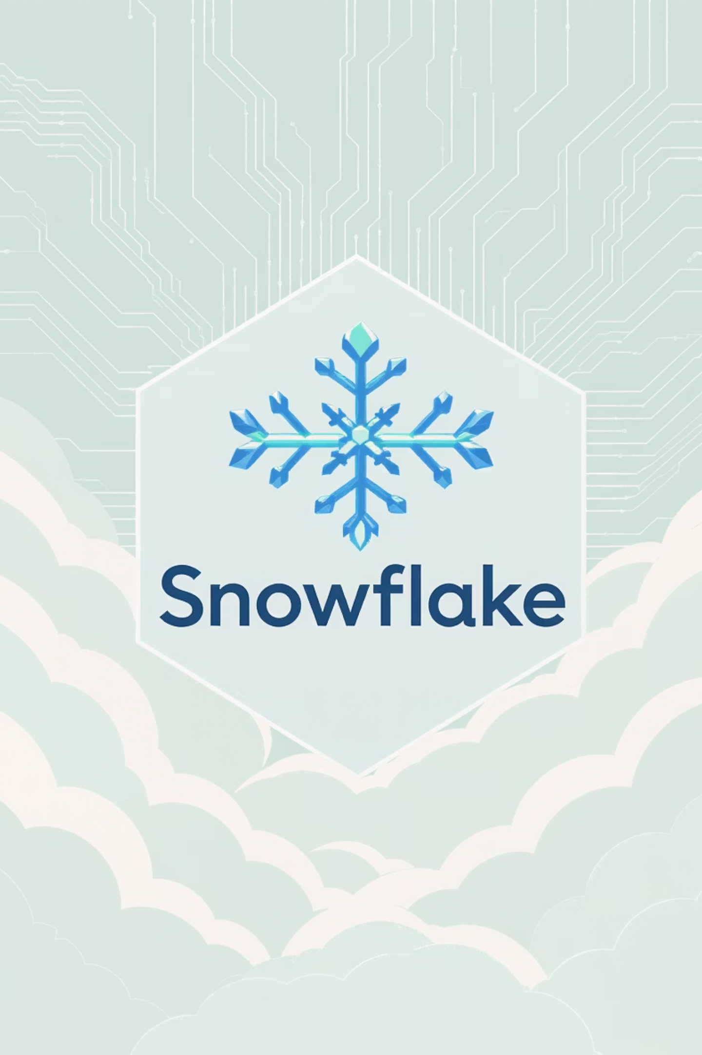
Unlocking the Power of Snowflake
A Comprehensive Guide for Data Professionals
By Gurleen Kaur

Slide 2



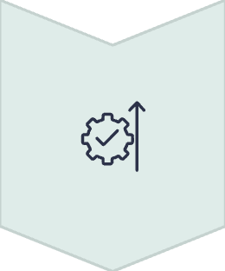
Day 1 Agenda
Introduction to Snowflake
Platform overview, key features, and cloud provider options
Snowflake Architecture
Multi-cluster shared data design and separation of compute and storage
Virtual Warehouses & Services
Understanding compute resources and the services layer
Implementation & Best Practices
Setting up for success and optimizing your Snowflake environment

Slide 3
What is a Data Warehouse?
Definition
Purpose
Technology
A large, centralized repository that collects, stores, and manages data from various sources within an organization, designed specifically to support business intelligence activities.
To enable data analysis, reporting, and informed decision-making by centralizing data from different sources, allowing organizations to identify patterns, trends, and insights.
Utilizes specialized technologies such as data modeling, ETL (extraction, transformation, loading) tools, and OLAP (Online Analytical Processing) systems to process and analyze large volumes of data.
Data warehouses can be built on-premises or in the cloud, with cloud-based solutions offering advantages in scalability, cost-effectiveness, and ease of use.

Slide 4
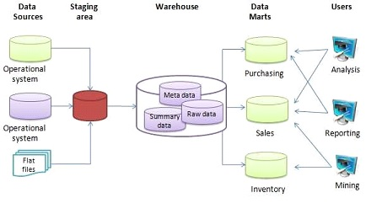
This Photo by Unknown Author is licensed under CC BY-SA

Slide 5

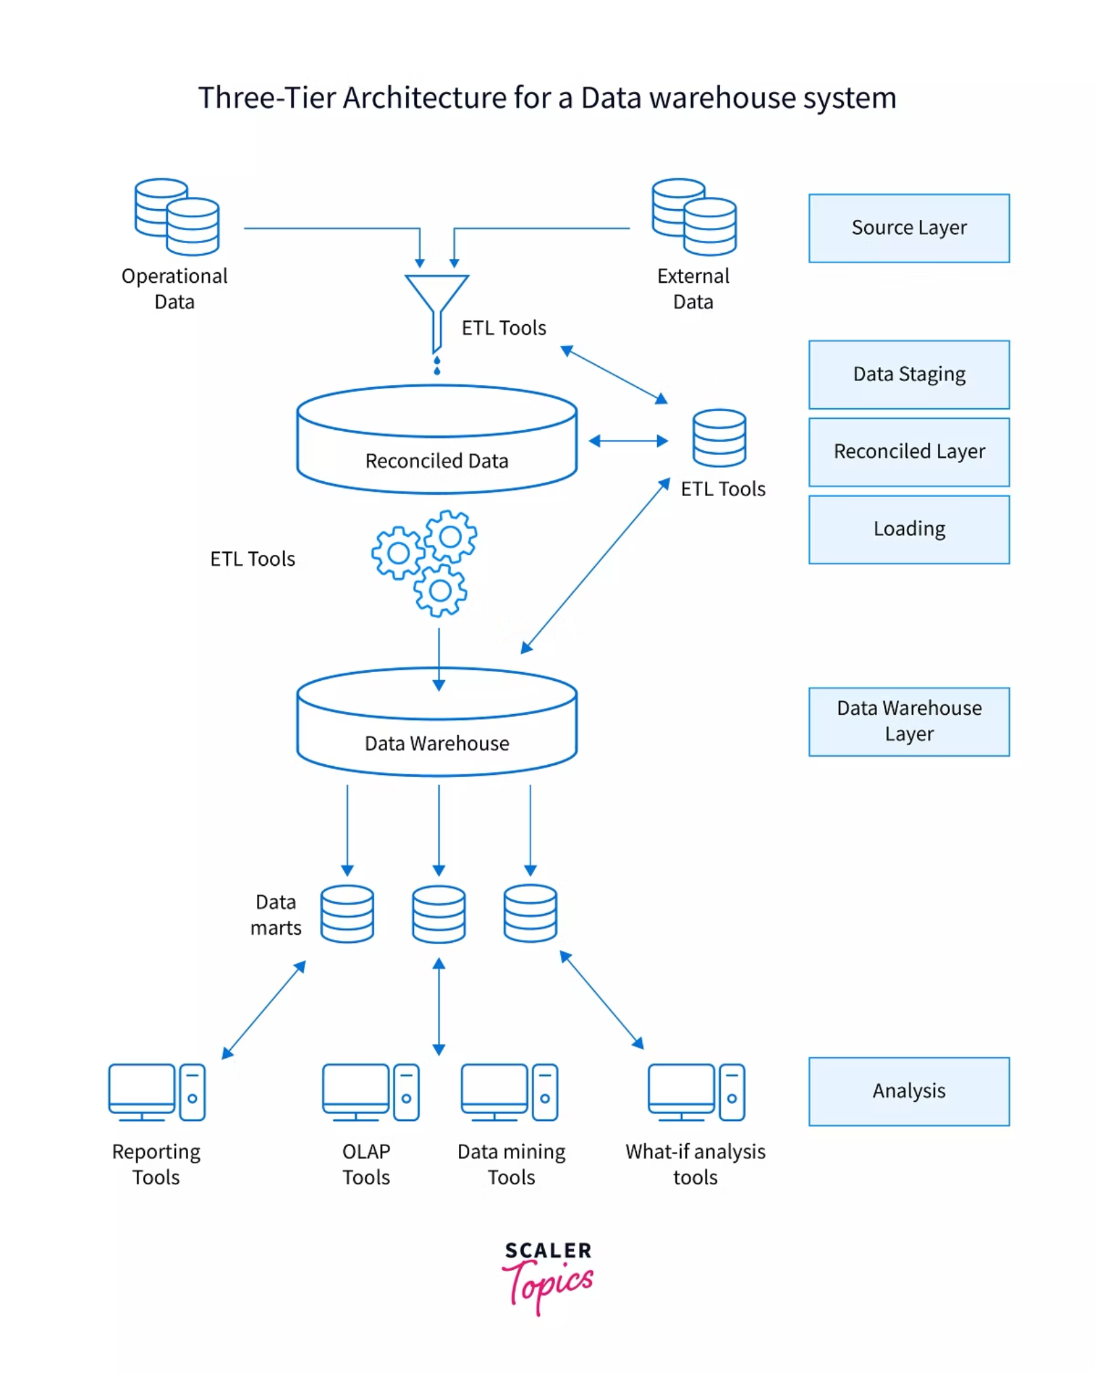
Types of Data Warehouse Architecture
There are 3 main architectural approaches to data warehousing, each with distinct advantages:
Single-Tier Architecture
Two-Tier Architecture
Aims to extract data in order to reduce the amount of data stored. Simplest approach with limited scalability.
Separates the actual Data Sources from the Database. This enables Data Warehouse to expand and support multiple end users.
Three-Tier Architecture
Features 3 phases: Data Warehouse Server Databases, intermediate Online Analytical Processing (OLAP) Server, and Advanced Client Framework with tools and APIs for data extraction.

Slide 6




Benefits of Virtual Warehouses
Elastic Scalability
Automated Management
Virtual Warehouses can be instantly started, suspended, and scaled up or down at any time without impacting active queries or operations.
Configure warehouses to auto-stop after periods of inactivity, minimizing costs, and automatically restart when a new query is submitted.
Controlled Auto-Scaling
Define minimum and maximum cluster sizes (e.g., min of 1, max of 3) for your warehouses, allowing Snowflake to automatically scale compute resources within these limits based on workload demands.

Slide 7
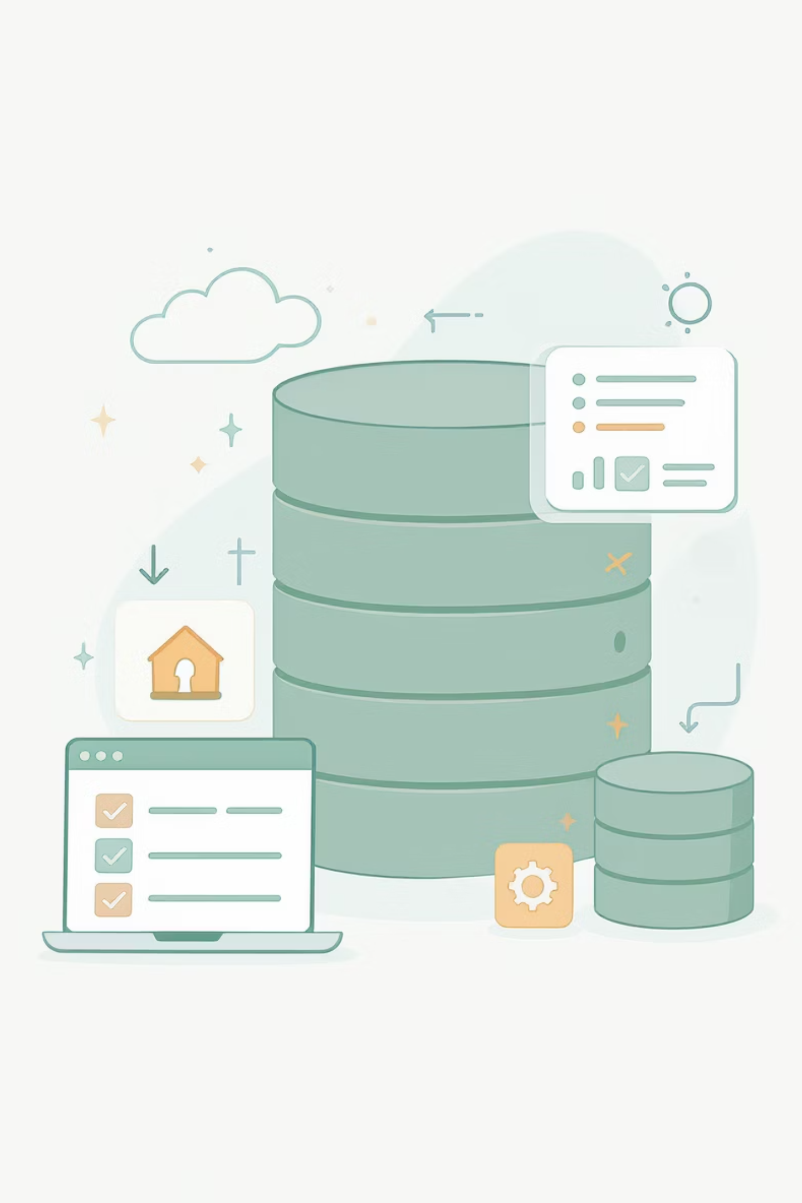
More Data Warehouse Components
Metadata
Provides the framework and definitions of data, allowing for the creation, storage, management, and use of data throughout the warehouse.
Database Access Tools
Allow users to access usable and business-friendly information. Include Data Reporting Tools, Data Inquiry Tools, Application Development Tools, Data Mining Tools, and OLAP Tools.

Slide 8
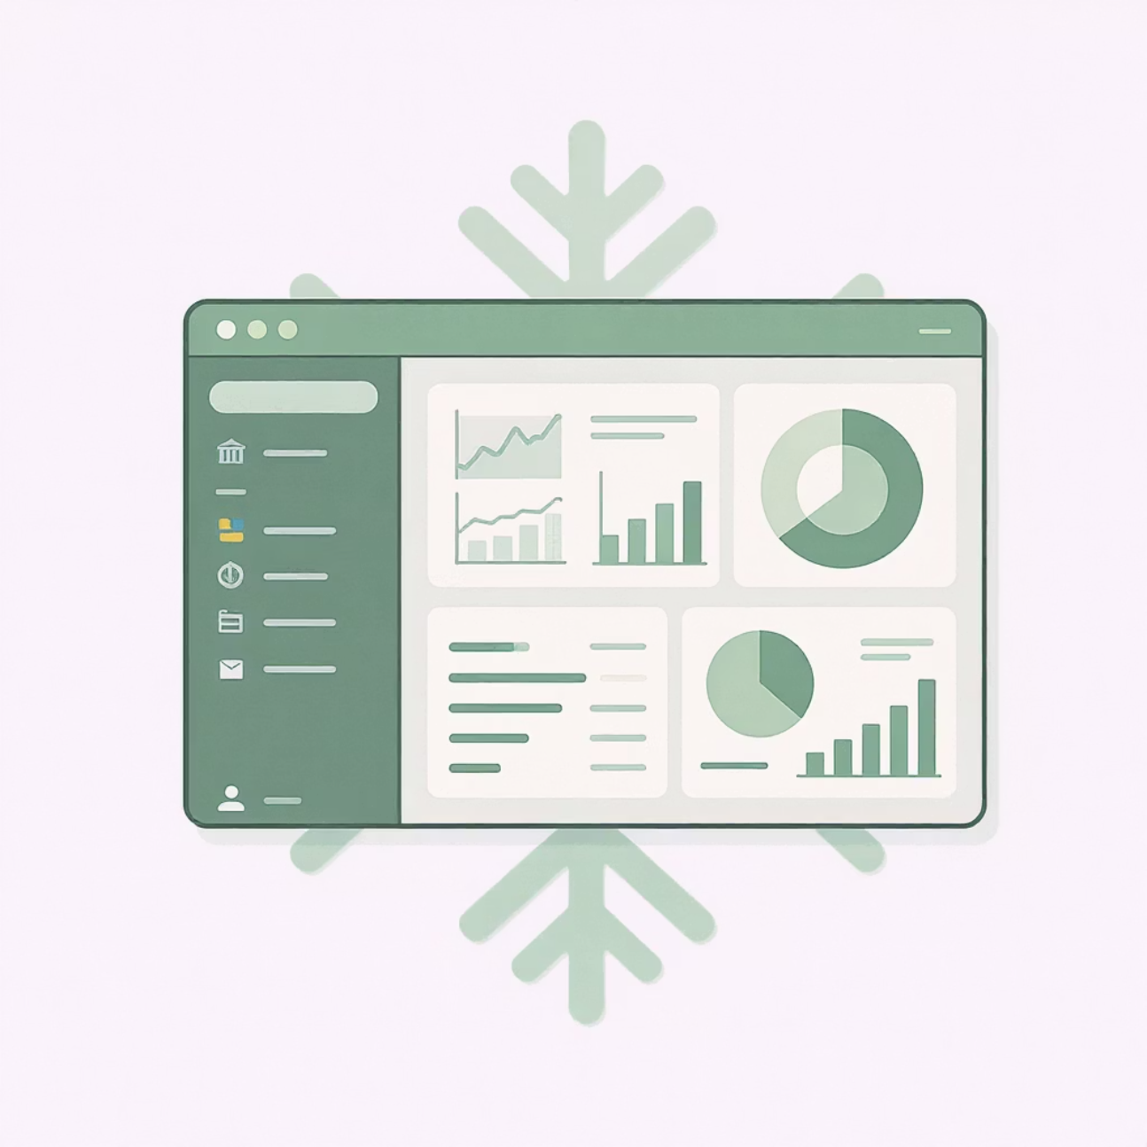
What is Snowflake?
Snowflake is a cloud-native data platform delivered as a Software-as-a-Service (SaaS) that provides organizations with:
Fully managed service with near-zero maintenance
Ability to store and analyze all your data in one place
Automatic scaling to handle varying workloads
Native support for structured and semi-structured data
Built-in security and governance features
Unlike traditional data warehouses, Snowflake was designed specifically for the cloud, enabling unprecedented elasticity, performance, and simplicity.

Slide 9


Cloud Data Warehouse Implementation
Data Warehouse Management
Cloud Provider Integration
Table, schema, and database setup
ETL data movement
SQL query optimization
Pipeline orchestration (Airflow, State functions)
Compute resource optimization
Processing frameworks (Spark, Python)
User access management
Deployment options (AWS Glue, EMR, SageMaker)
Data readiness for analytics
Logging, alerting, and notifications
When building a data pipeline on cloud, optimization is critical in terms of both performance and cost..

Slide 10
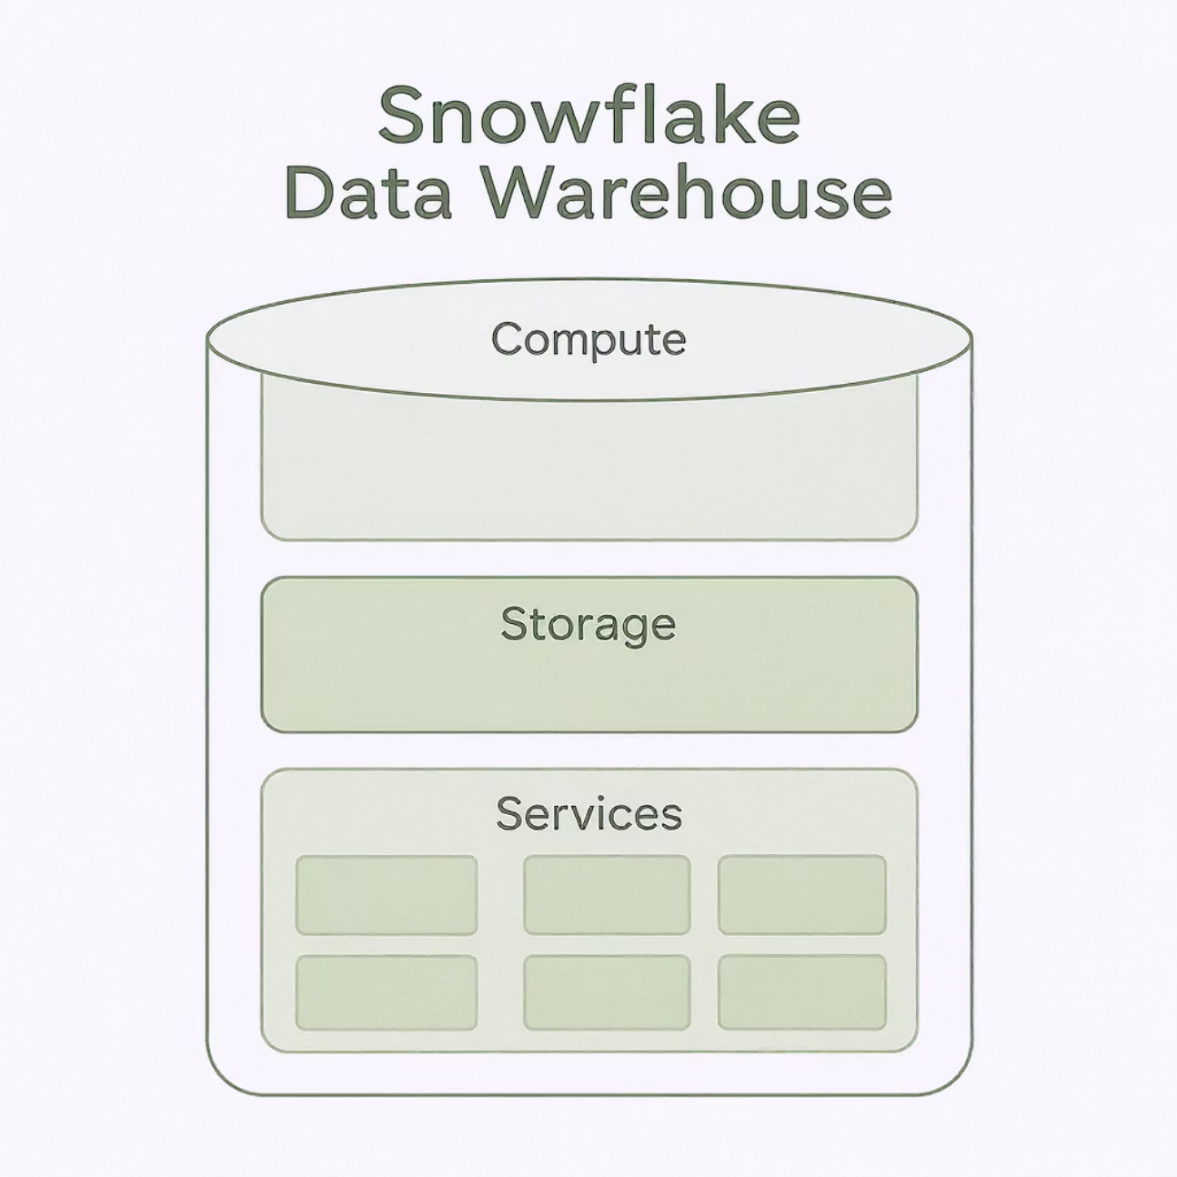
Key Features of Snowflake Data Warehouse
Key Features
Advanced authentication (MFA, federal authentication, SSO, Oath)
Comprehensive SQL support (DDL, DML, transactions, lateral views)
Extensive connectivity options (Python, Spark, Node.js, .NET)
Secure data sharing capabilities between accounts

Slide 11
Snowflake's Partner Connect Program
Unlike competitors like BigQuery and Redshift, Snowflake doesn't include native tools for specialized services such as machine learning and business intelligence. Instead, Snowflake takes a different approach:
Ecosystem Approach
Core Storage Engine
Partner Connect
Works with a wide range of industry-leading technology partners to build connectors and drivers, creating a comprehensive analytics ecosystem.
Positions itself as a core data storage engine while enabling data flow to and from various third-party integrations for specialized tasks.
An extension that allows users to easily connect their Snowflake account with trial accounts from select third-party integrations to test and choose optimal solutions.

Slide 12

Optimized Table Structures in Snowflake
Query performance and table optimization are handled automatically in Snowflake through micro-partitions and data clustering, eliminating the need to manage indexes, partitions, or data sharding.
Micro-partitions
Clustered Tables
Tables automatically divided into 50-500 MB micro-partitions
Data ordered on subset columns (clustering key)
Creates uniformly-sized partitions to limit data skew
Clustering metadata collected during data load
Enables granular pruning of large tables
Metadata leveraged to avoid unnecessary scanning
Queries scan only relevant partitions and columns
Explicit clustering keys available for very large tables

Slide 13
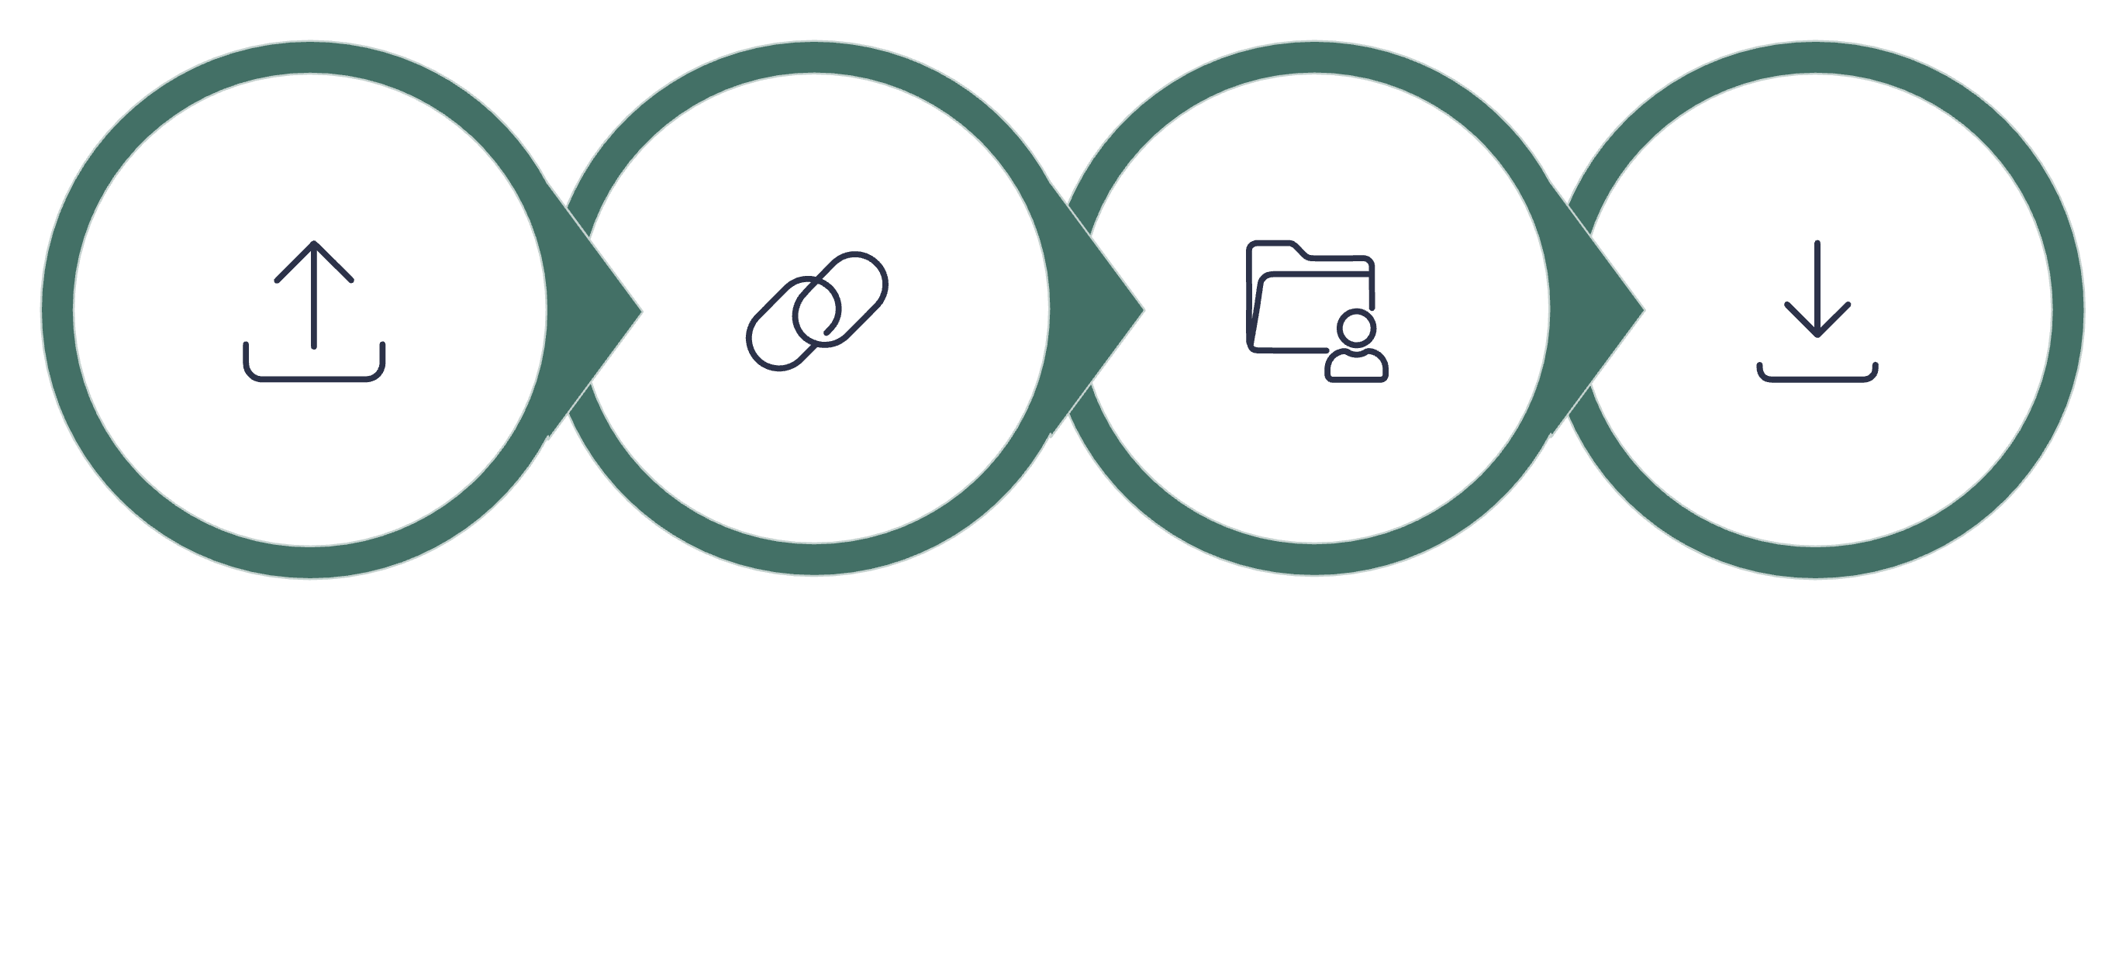




Secure Data Sharing Between Accounts
Provider
Share
Metadata
Consumer
Snowflake's innovative secure data sharing allows sharing database objects between accounts without creating data copies. This means:
Shared data doesn't consume additional storage or contribute to consumer costs
Setup is quick with instantaneous data access through Snowflake's metadata store
Creates a network of data providers and consumers for various use cases
Key Applications
Snowflake Data Marketplace connects providers sharing free or paid data with consumers, while Data Exchange facilitates collaboration between business customers, suppliers, and partners. Reader accounts provide cost-effective access for non-Snowflake users.

Slide 14
Zero-Copy Clones & Object Recovery
Zero-Copy Clones
UNDROP Command
Traditional data warehouses require deploying separate environments and reloading data for cloning, which is costly and time-consuming. Snowflake's zero-copy cloning:
Recovering from mistakes like dropping the wrong table typically requires time-consuming backup restoration. Snowflake's UNDROP command:
Creates instantaneous clones without duplicating data
Recovers objects instantaneously
Tracks changes in metadata while referencing original files
Works as long as you're within the recovery window
Enables multiple independent clones without additional costs
Eliminates the need for complex backup restoration
Works with time travel to clone data from past points
Provides protection against accidental data loss

Slide 15
Semi-Structured Data Support
One of Snowflake's major advantages is its ability to combine structured and semi-structured data without requiring complex technologies like Hadoop or Hive.
Multiple Data Formats
Optimized Storage
Easy Data Manipulation
Supports ingestion of semi-structured data in various formats including JSON, Avro, ORC, Parquet, and XML using the VARIANT data type (with 16MB size limit).
Extracts as much data as possible in columnar form and stores the rest as a single column, optimizing both storage and query performance.
Provides data functions to parse, extract, cast, and manipulate data, making it easy to flatten nested structures in semi-structured data.
This capability is particularly valuable for handling machine-generated data, sensor data, and information from mobile devices without requiring specialized big data expertise.

Slide 16
Core Components of Data Warehouses
Database Warehouse Database
ETL Tools
Forms an integral part of the system. Stores and provides access to corporate data. Cloud examples include Amazon Redshift and Azure SQL.
Extraction, Transform, and Load tools handle all activities associated with extracting data from multiple sources, converting it to readable format, and uploading to the Data Warehouse.

Slide 17
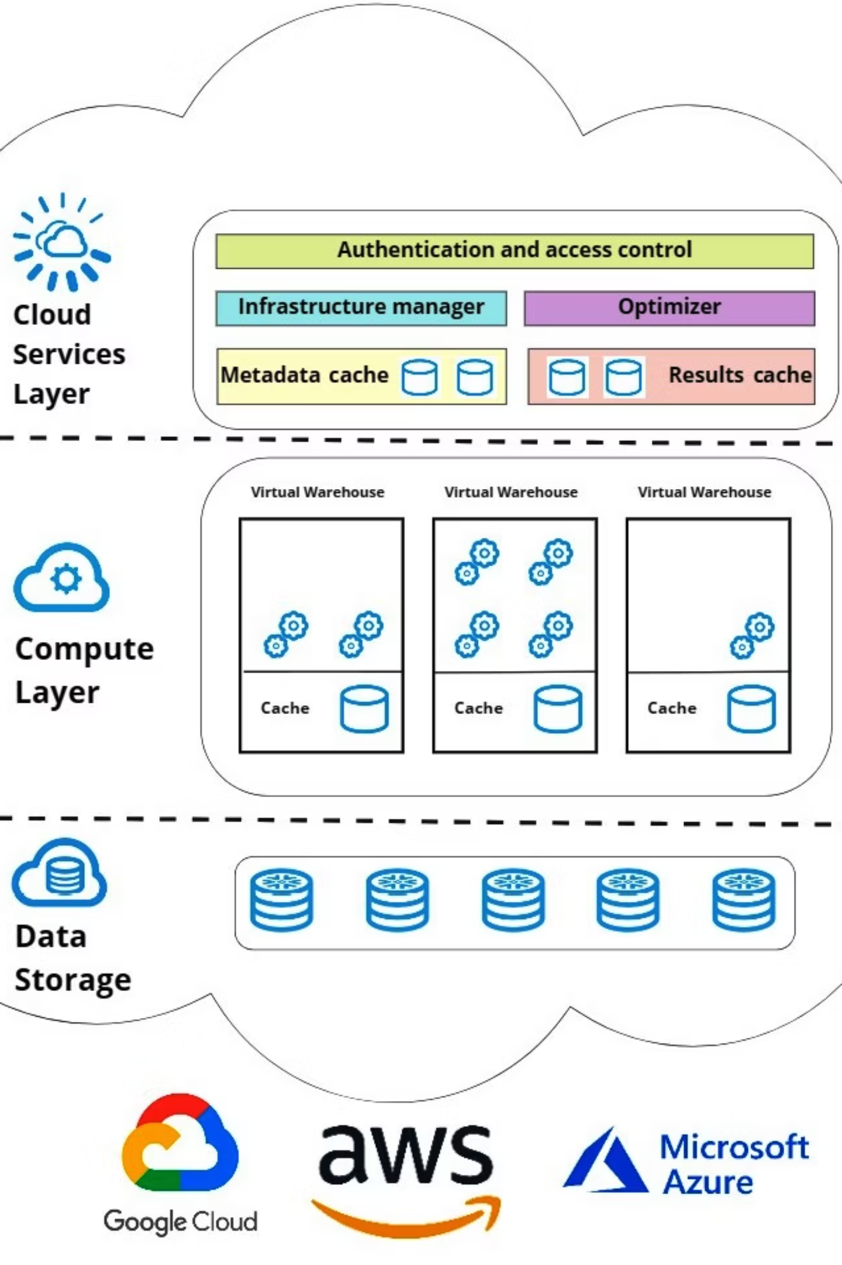
Snowflake's Three-Layer Architecture

Slide 18
Snowflake's Three-Layer Architecture
Cloud Services Layer
Query Processing Layer
Provides administration and management services including access control, authentication, metadata management, infrastructure management, query parsing, optimization, and more.
Database Storage Layer
Executes queries using virtual warehouses. These are independent MPP compute clusters comprised of multiple compute nodes allocated from cloud providers. Performance is independent as warehouses don't share compute resources.
Reorganizes loaded data into columnar, compressed, and optimized format. The optimized data is stored in cloud storage, providing a shared repository accessible to all compute nodes.

Slide 19
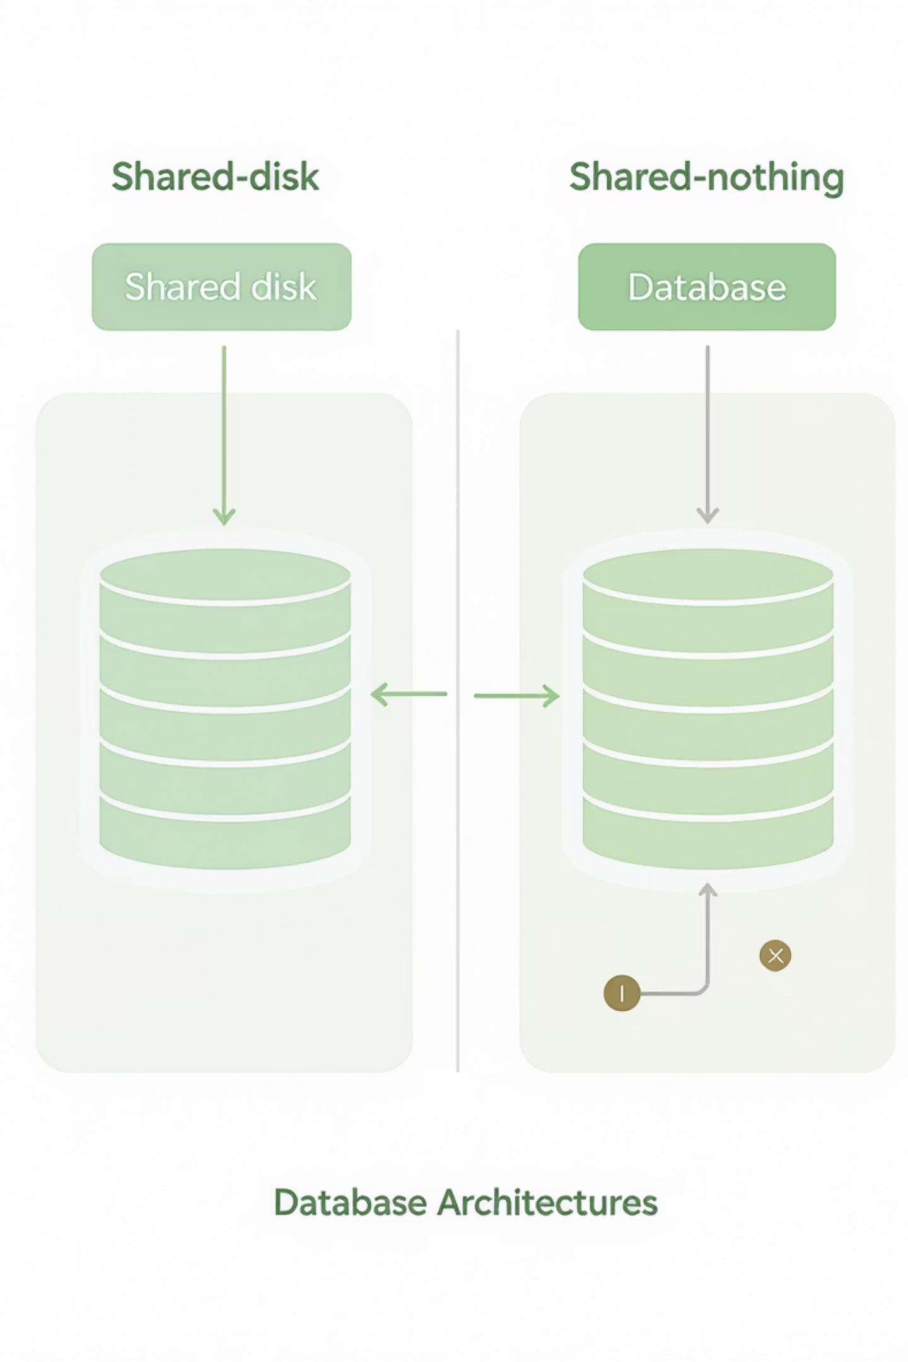
Traditional Database Architectures
Shared-Disk Architecture
Shared-Nothing Architecture
Used on standard websites, this architecture has a single storage layer accessible to all cluster nodes. Multiple cluster nodes with CPU and Memory (but without disk storage) connect to the central storage layer for data processing.
In contrast to Shared-Disk, this architecture distributes cluster nodes with their own disk storage, CPU, and Memory. The advantage is that data can be categorized and stored across all cluster nodes as each has its own disk storage.

Slide 20
Snowflake's Storage Layer
The foundation of Snowflake's hybrid architecture:
Organizes data into many smaller compartments that are internalized and compressed
Uses columnar format for efficient storage
Data is stored in cloud storage, acting as a shared disk model for ease of data management
Users don't have to worry about data distribution across multiple nodes
Computation nodes connect to the storage layer to download data for query processing
Storage layer is independent - you only pay for the monthly storage amount used
Storage is expandable and charged per monthly TB usage

Slide 21
Snowflake's Compute Layer
Snowflake uses "Virtual Warehouses" to process queries, separating query processing from disk storage:
Virtual Warehouse Structure
Independent Operation
MPP clusters include multiple nodes with CPU and Memory provided in the cloud. Multiple Virtual Warehouses can be created for various workloads. Each warehouse operates independently on the shared storage layer.
Each Virtual Warehouse has its own independent compute collection and does not interact with other warehouses, ensuring consistent performance regardless of overall system load.

Slide 22
Snowflake's Cloud Services Layer
All functions such as authentication, security, metadata management, and query integration occur in this layer:
1
2
3
All access requests must go through this layer for authentication and security
Queries sent to Snowflake are processed in this layer and forwarded to the Compute Layer for execution
Metadata needed to optimize queries or filter data is stored and managed in this layer
These three layers (Storage, Compute, Cloud Services) scale independently, with Snowflake charging separately for storage and compute resources. The service layer is managed within allocated compute nodes.

Slide 23



Connecting to Snowflake
Snowflake offers a rich ecosystem of connectivity options:
Snowflake Ecosystem
Partner Connect
SnowSQL (CLI)
Includes Snowflake partners, customers, third-party tools, and emerging technologies. Partners provide native connections, data integration tools, business intelligence capabilities, and advanced analytics.
Access to Snowflake Partners offering free connection trials to integrate with your existing tools and platforms.
Next-generation command line utility to connect to Snowflake. Allows you to create SQL queries and perform all DDL and DML tasks.

Slide 24






Snowflake Connectors and Drivers
Snowflake provides numerous drivers and connectors to improve application integration:
Python
Spark
Python Snowflake connector for data science and application development
Spark Snowflake connector for big data processing
Kafka
Node.js
Kafka Snowflake connector for real-time data streaming
Node.js driver for JavaScript applications
.NET
JDBC/ODBC
.NET Driver for Microsoft platform integration
Standard database connectivity drivers for broad application support

Slide 25
Continuous Data Pipelines
Snowflake automates many manual steps involved in loading and transforming data through continuous data pipelines, offering several key features:
Tasks
Table Streams
Allows scheduling of SQL statements to create automated workflows for continuous data processing and transformation.
Snowpipe
Captures metadata about DML changes made to tables and the state of rows before and after changes, enabling change data capture (CDC) to process only modified data.
Continuous data ingestion service that loads fresh data in micro-batches as soon as it's available in external stages like AWS S3, making data available within minutes rather than requiring manual batch loading.

Slide 26




Key Features That Set Snowflake Apart
Instant Elasticity
Pay-Per-Use Model
Scale compute resources up or down within seconds based on workload demands. Multiple workloads can run simultaneously without resource contention.
Only pay for the storage and compute resources you actually use. Compute costs are charged per-second, with automatic suspension when idle.
Secure Data Sharing
Time Travel & Zero-Copy Cloning
Share live data across accounts without copying or moving it. Enable secure collaboration with partners and customers through governed access.
Access historical data at any point within a defined period. Create instant database copies without duplicating storage to support testing and development.

Slide 27

Business Benefits of Snowflake
Beyond technical capabilities, Snowflake delivers substantial business value:
Accelerated time-to-insight: From raw data to actionable analytics in minutes instead of days
Reduced operational overhead: No infrastructure to manage means your team focuses on data, not servers
Simplified data access: Democratize data across the organization with appropriate governance
Cost optimization: Right-size resources and only pay for what you use
Future-proof architecture: Continuously updated with new features without disruption

Slide 28




Snowflake Editions
Enterprise
1
For organizations with advanced security and governance needs
Business Critical
2
Highest level of data protection with HIPAA and PCI compliance
Enterprise
3
Enhanced security and materialized views
Standard
4
Core features for data warehousing workloads
Each edition builds upon the previous one, adding more capabilities. Edition choice impacts features like data retention period for Time Travel, security options, and service level agreements (SLAs).

Slide 29
Multi-Cloud Deployment Options
Amazon Web Services (AWS)
Microsoft Azure
Google Cloud Platform (GCP)
The original Snowflake platform, available in the most regions globally. Offers the deepest integration with AWS services like S3, Lambda, and SageMaker.
Excellent choice for organizations heavily invested in the Microsoft ecosystem. Integrates with Azure Data Factory, Azure Synapse, and Power BI.
Great option for organizations leveraging Google's analytics tools. Integrates with BigQuery, Looker, and Google Cloud Data Fusion.
Snowflake's architecture is consistent across all cloud providers, making migration between clouds or multi-cloud deployments significantly easier than with other platforms.

Slide 30
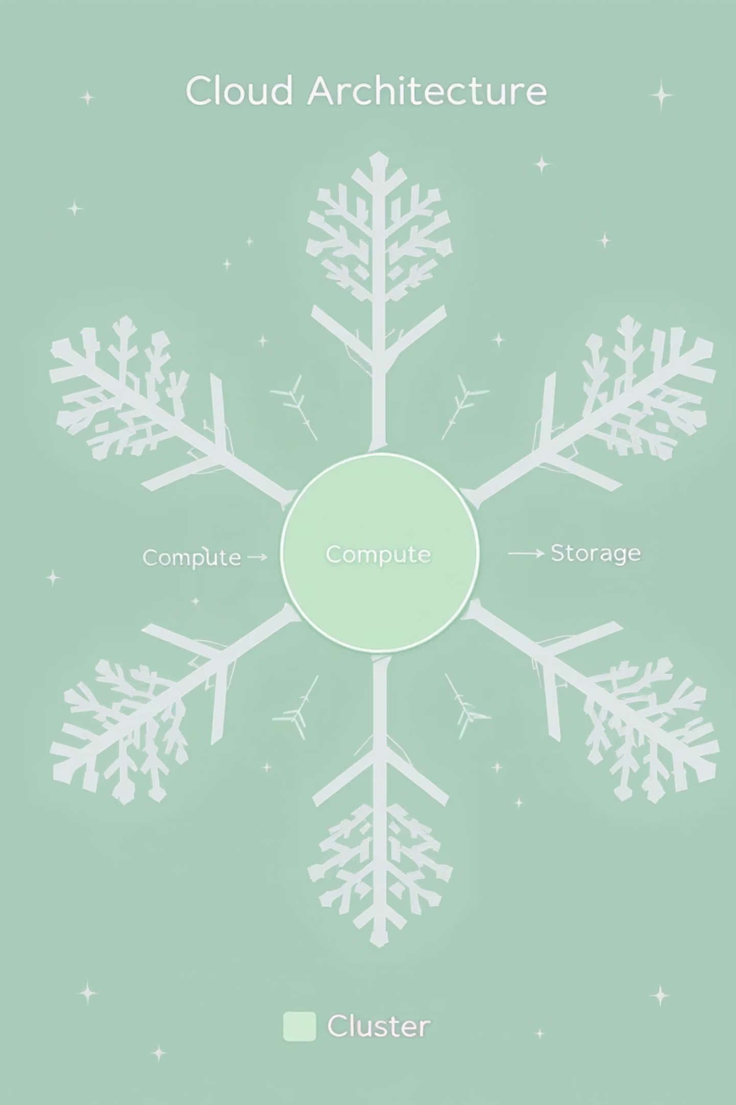
Snowflake's Unique Architecture
At the heart of Snowflake's innovation is its revolutionary architecture that separates compute from storage while maintaining high performance.
Database Storage: Optimized columnar storage format with automatic compression
Query Processing: Massively parallel processing (MPP) across virtual warehouses
Cloud Services: Handles authentication, infrastructure management, metadata, and query optimization
This separation enables independent scaling and creates a foundation for Snowflake's unique value proposition in the data platform market.

Slide 31
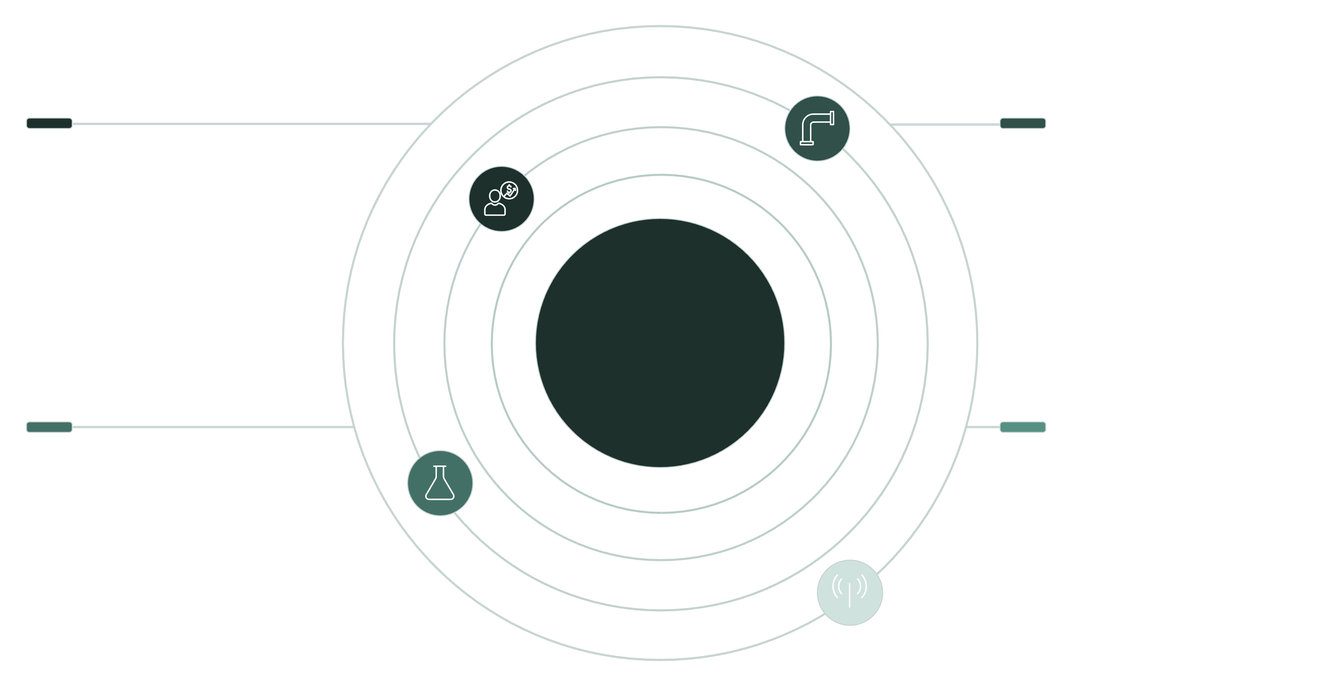




Multi-Cluster Shared Data Architecture
Analytics Warehouse
ETL/ELT Warehouse
High-concurrency BI and reporting workloads
Data ingestion and transformation pipelines
Shared Data Layer (Snowflake)
Data Science Warehouse
Real-time/Streaming Warehouse
Model training and exploration compute
Low-latency streaming and serving
This architecture allows multiple compute clusters to work on the same data simultaneously without interference. Data scientists, analysts, and engineers can all run their workloads without impacting each other's performance.

Slide 32

Separation of Compute and Storage
Traditional Architecture
Snowflake Architecture
Fixed compute and storage resources
Decoupled compute and storage layers
Scale up requires both even if only one is needed
Independent scaling of each component
Performance degrades as data volumes grow
Consistent performance regardless of data volume
Expensive over-provisioning to handle peak loads
Pay only for what you use, scale on demand
Complex upgrades and maintenance windows
Zero-maintenance, continuous upgrades
This separation is the foundation for Snowflake's elasticity and cost-efficiency. It allows you to appropriately size resources for different workloads without compromising on performance.

Slide 33

Snowflake Storage Architecture
Snowflake organizes all data into micro-partitions, which are immutable files optimized for efficient storage and querying:
Columnar storage format for efficient scans and compression
Automatic partitioning and pruning during queries
Metadata-driven optimization without manual tuning
Transparent encryption at rest and in transit
This architecture eliminates the need for complex indexing, partitioning, or vacuuming operations that traditional databases require.

Slide 34








Virtual Warehouses: Snowflake's Compute Layer
Sizing Options
Workload Isolation
From X-Small to 6X-Large, offering flexibility to match compute power to workload needs
Dedicate warehouses to specific departments or workload types without resource contention
Auto-Scaling
Auto-Suspension
Dynamically adds or removes compute clusters based on concurrent user demands
Automatically pauses warehouses after a period of inactivity to prevent unnecessary costs
Virtual warehouses are Snowflake's MPP compute clusters that execute SQL queries against your data. They can be started, stopped, resized, or scaled out in seconds.

Slide 35
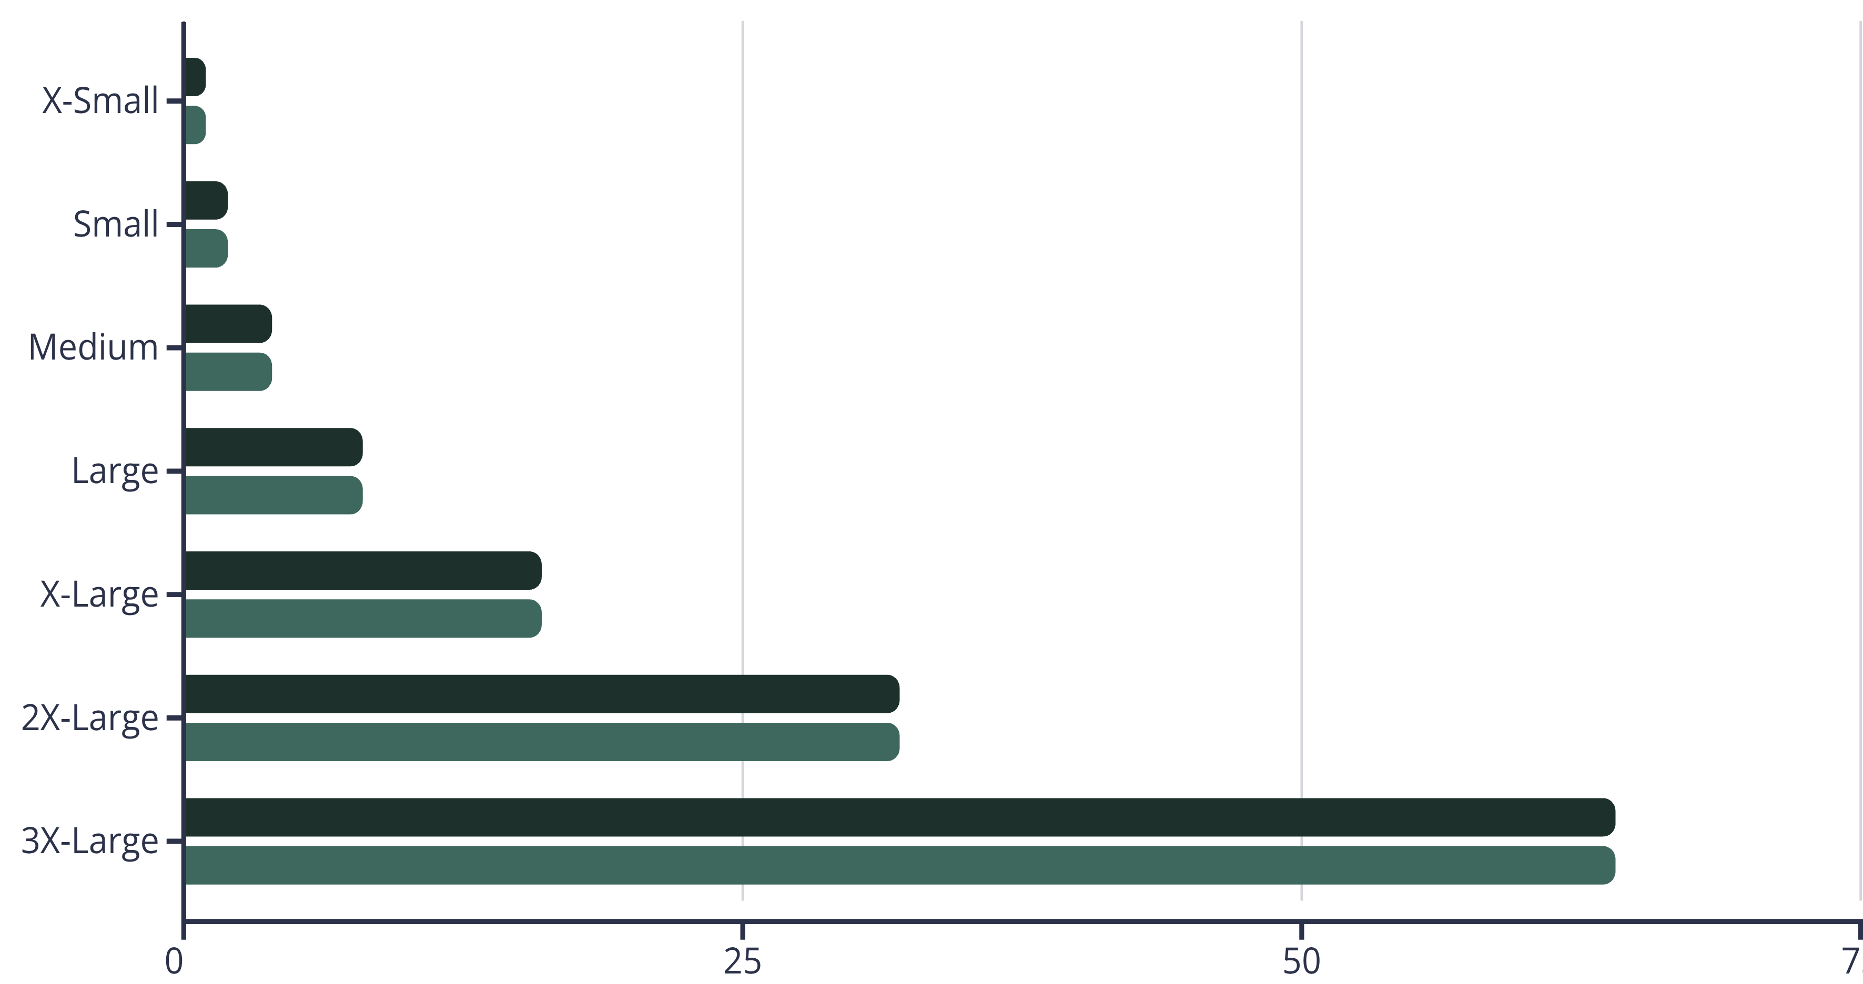
Warehouse Sizing and Performance
Relative Performance
Relative Cost
Each warehouse size doubles the computing power and cost of the previous size. This linear scaling makes it easy to right-size warehouses for specific workloads. A crucial best practice is to match warehouse size to query complexity rather than defaulting to larger sizes.

Slide 36
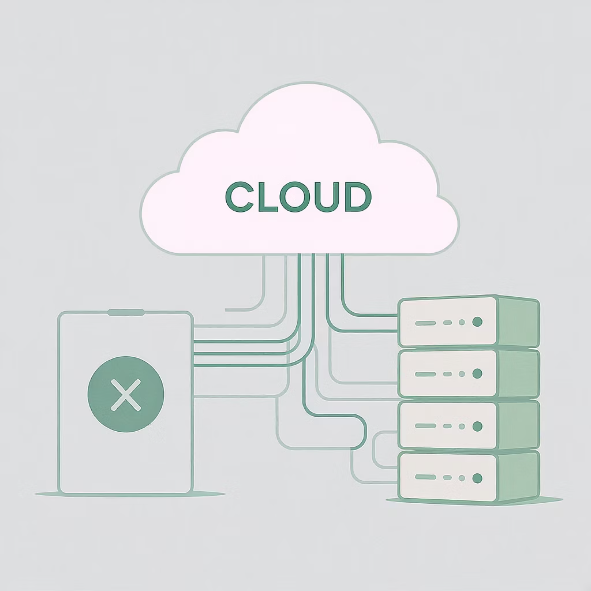
Services Layer: The Brain of Snowflake
The services layer provides the intelligence that powers Snowflake's platform:
Authentication and access control: Managing users, roles, and security
Query optimization and compilation: Converting SQL to efficient execution plans
Metadata management: Tracking all objects and their relationships
Transaction management: Ensuring ACID compliance and consistency
Infrastructure management: Handling scaling, failover, and updates
This layer abstracts away the complexity of distributed systems, making Snowflake appear as a single, cohesive database to users.

Slide 37





Putting It All Together: The Snowflake Experience
Ingestion
Collect data from sources
Storage
Store in Snowflake tables
Processing
Compute with virtual warehouses
Analytics & Sharing
Query, analyze, and share

Slide 38




Data Loading and Integration
Data Sources
Loading Methods
Structured data from databases, semi-structured data (JSON, XML, Parquet), cloud storage, and streaming sources
COPY command, Snowpipe (continuous loading), external tables, and partner ETL/ELT tools
Transformation
Storage
SQL-based transformations, stored procedures, and support for Python/Java UDFs
Optimized columnar format with automatic compression and encryption
Snowflake offers multiple paths for loading data, supporting both batch and streaming patterns. The platform's flexibility allows you to adapt your data ingestion strategy to your specific requirements.

Slide 39
Getting Started with Snowflake: First Steps
1
2
Set Up Your Account
Configure Users and Roles
Start with Snowflake's 30-day free trial and select your preferred cloud provider and region. Consider data residency requirements and proximity to other cloud services.
Establish a role hierarchy following least-privilege principles. Create functional roles (analyst, engineer, admin) rather than mapping directly to individuals.
3
4
Create Virtual Warehouses
Establish Database Objects
Set up separate warehouses for different workloads (ETL, BI, data science). Start small and scale up as needed based on performance monitoring.
Design your database, schema, and table structure. Consider organizing by business domain or data product rather than source systems.

Slide 40

Performance Optimization Best Practices
What To Do
What To Avoid
Use appropriate warehouse sizes for workloads
Using one warehouse size for all workloads
Leverage clustering keys for large tables with selective queries
Over-clustering tables unnecessarily
Take advantage of caching (result, metadata, warehouse)
Running queries with LIMIT without ORDER BY
Use materialized views for common calculations
Creating excessive micro-partitions (files < 100MB)
Consider multi-cluster warehouses for concurrent users
Leaving large warehouses running when idle
Monitor query performance with QUERY_HISTORY
Writing inefficient joins and window functions
Snowflake requires far less performance tuning than traditional databases, but these best practices can help you optimize both performance and cost.

Slide 41
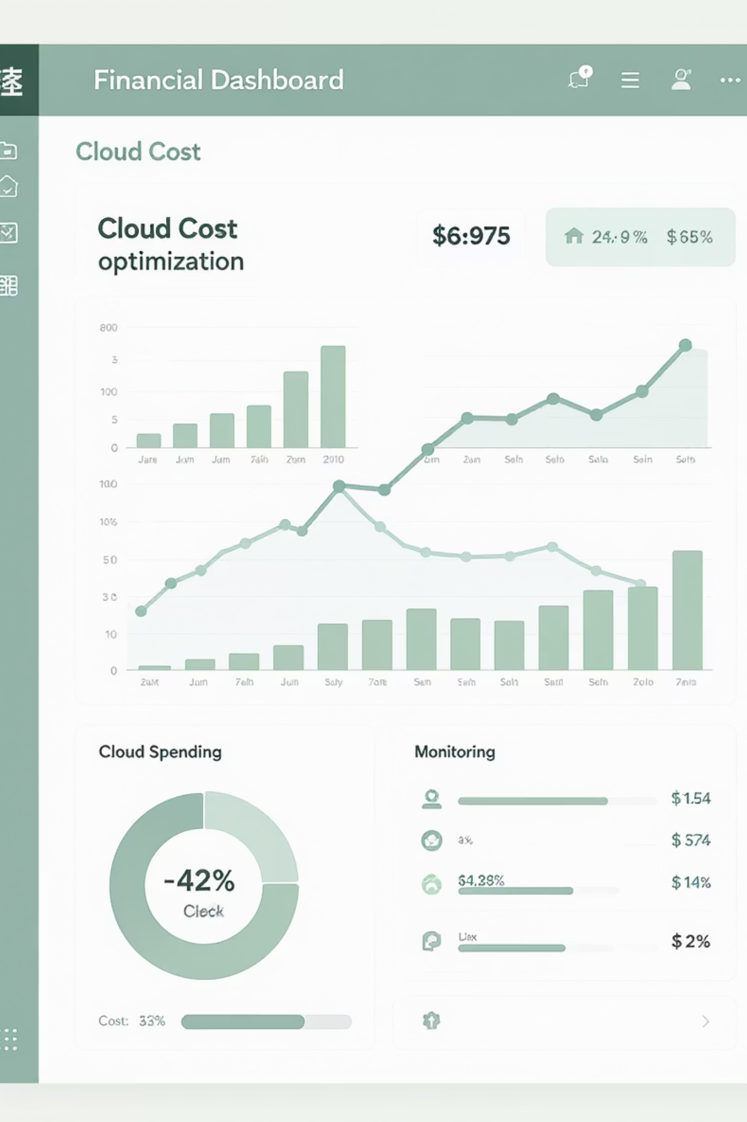
Cost Management Strategies
Effectively managing Snowflake costs requires balancing performance needs with resource usage:
Resource Monitoring
Auto-suspension Tuning
Set up resource monitors with notifications and automated actions when spending approaches thresholds. Monitor both at the account and warehouse levels.
Adjust the auto-suspension timeout based on usage patterns. For infrequent workloads, set shorter timeouts (1-5 minutes); for frequent access, slightly longer (5-10 minutes).
Storage Optimization
Implement data lifecycle policies to move aging data to lower-cost storage. Use zero-copy cloning instead of duplicating data for development environments.

Slide 42
Key Takeaways
Snowflake's architecture separates compute from storage
Virtual warehouses provide flexible compute resources
This fundamental design choice enables independent scaling, workload isolation, and pay-as-you-go pricing that traditional data platforms can't match.
Size and scale warehouses appropriately for different workloads to optimize both performance and cost. Use auto-suspension and auto-scaling features.
Snowflake requires minimal administration
Start small and grow incrementally
The platform handles most traditional database administration tasks automatically, freeing your team to focus on delivering data value rather than maintaining infrastructure.
Begin with core use cases and expand as you become more familiar with the platform. Snowflake's elasticity makes it easy to adapt as your needs evolve.

